Slide 1
Unit 4 Software Design
By
Nikhita Mangaonkar

Slide 2



Contents
ARCHITECTURAL DESIGN CLIENT SERVER & PIPE AND FILTER
UML DIAGRAMS – BEHAVIOR VIEW AND IMPLEMENTATION VIEW
DESIGN PATTERNS – GANG OF FOUR PATTERNS

Slide 3

What is the Visual all about ?

Slide 4
Why this language has gain importance and widely accepted ?
The answer lies in the proverb -
“One picture is worth thousand words”

Slide 5
What is UML ?
Unified Modeling Language - is a standardized modeling language consisting of an integrated set of diagrams, developed to help system and software developers for specifying, visualizing, constructing, and documenting the artifacts of software systems, as well as for business modeling and other non-software systems.
It is a Visual Language for understanding the software from stakeholders point of view.

Slide 6
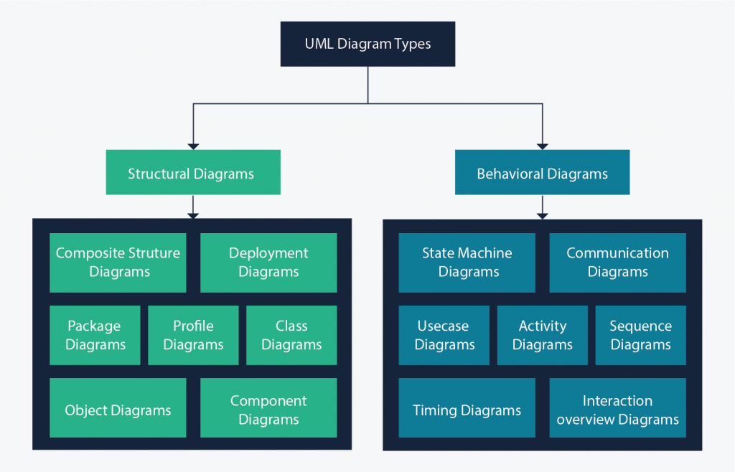
Classification of UML Diagrams

Slide 7
History of UML
UML is a notation that resulted from the unification of OMT from
Object Modeling Technique OMT [James Rumbaugh 1991] - was best for analysis and data-intensive information systems.
Booch [Grady Booch 1994] - was excellent for design and implementation. Grady Booch had worked extensively with the Ada language, and had been a major player in the development of Object Oriented techniques for the language. Although the Booch method was strong, the notation was less well received (lots of cloud shapes dominated his models - not very tidy)
OOSE (Object-Oriented Software Engineering [Ivar Jacobson 1992]) - featured a model known as Use Cases. Use Cases are a powerful technique for understanding the behaviour of an entire system (an area where OO has traditionally been weak).
In 1994, Jim Rumbaugh, the creator of OMT, stunned the software world when he left General Electric and joined Grady Booch at Rational Corp. The aim of the partnership was to merge their ideas into a single, unified method (the working title for the method was indeed the "Unified Method").
By 1995, the creator of OOSE, Ivar Jacobson, had also joined Rational, and his ideas (particularly the concept of "Use Cases") were fed into the new Unified Method - now called the Unified Modelling Language1. The team of Rumbaugh, Booch and Jacobson are affectionately known as the "Three Amigos

Slide 8
Polling Service
Create Poll
Add multiple questions
Each user can poll only once
Duration has to be fixed
Graphical format needs to be seen for poll
History has to be maintained
Student wise performance
Registration and Users

Slide 9
Polling Service
What are you trying to look at ?Is it an App, website,chatbot ,standalone .
SYSTEM BOUNDARY
Polling Service website

Slide 10
Polling Service
Who is an Actor? -A user or outside system that interacts with the system being designed in order to obtain some value from that interaction
ACTOR

Slide 11
Polling Service
A use case is a summary of scenarios for a single task or goal
USE CASE (FUNCTIONALITY)
Create Poll

Slide 12
Polling Service
Represents the inclusion of the functionality of one use case within another
INCLUDE RELATIONSHIP
Create Poll
include
Add Questions

Slide 13
Polling Service
Represents the extension of the use case to include optional functionality
EXTEND RELATIONSHIP
Registered User
extend
poll

Slide 14
Polling Service
Generalization Relationship
Represented by a line and a hollow arrow
From child to parent
Old student

Slide 15
Use Case Notations
System boundary
Actor or Actors
Use case
Relationships

Slide 16
Use Case
A formal way of representing the activities that are performed by the users of the system.
A scenario-based technique in the UML
A sequence of actions a system performs that yields a valuable result for a particular actor.

Slide 17
Case study Courseware Management System
Construct the design element for a course ware management system that can be used to manage courses and classes for an organization that specialize in providing training.
The organization offers a variety of courses in variety of areas such as learning management techniques & understanding different software languages and technologies.
Each course is made up of set of topics.
Tutors in the organization are assigned courses to teach according to the area that they are specialized in and their availability.
The organization publish and maintains a calendar of different courses and assign tutor every year
There is a group of course Administrator in the organization to manage the courses including course content, assign courses to tutor and define the course schedule.
The training organization aim to use the courseware management system to get a better control and visibility to the management of courses as also to streamline the process of generating and managing the schedule of the different courses.

Slide 18
Case study Courseware Management System
1
2
3
4
5
6
Identify the list of actors.
Identify the use cases.
Identify the relationship between the actors and the use cases
Identify whether the relationship include and extends thus exist in the above scenario
Check whether the diagram is logically correct or Not.(Notations, Action words)
List out and rectify the logical and diagrammatical error

Slide 19
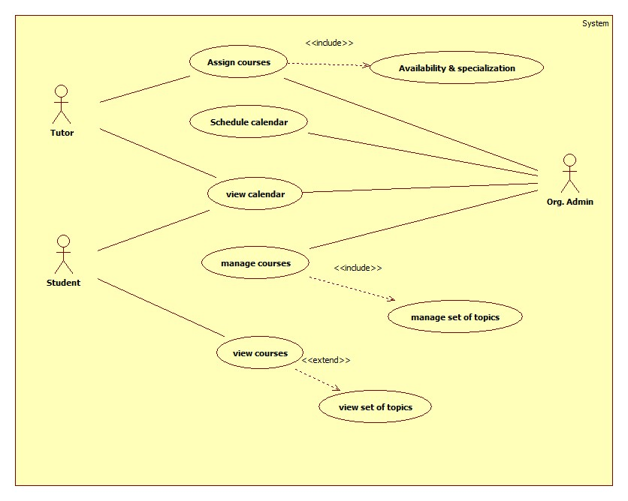
Case study Courseware Management System

Slide 20
Specification: Courseware Management System
Use Case ID: | CW1
Use Case Name: | Courseware management system
Created By:
Date Created:
Actor: | 1.Tutor 2.Organisation_administrator 3.Students
Description of use cases: | 1. Assign course – Organisation_administrator assign courses to the tutor 2. Schedule calendar – Organisation_administrator manages and publishes the calendar 3. View calendar – Organisation_administrator , tutor and Student can view the calendar schedule 4. Manage courses – Organisation_administrator manages the topics for the each course 5. View courses – Students can view courses and related topics.
Preconditions: | 1.The Organisation_administrator and the tutor has to be authenticated.
Postconditions: | 1.Assign courses – Courses are assigned to the tutor by Administrator 2.Schedule calendar – As Organisation_administrator changes the schedule, it needs to be reflected in the calendar 3. Manager courses – As Organisation_administrator changes the topics of the course, it needs to be reflected accordingly
Extends: | 1.View set to topics may or may not invoke view courses
Includes: | 1.Assign Courses always invokes Availability & Specialization 2.manage courses always invokes manage set of topics
Assumptions: | Student as actor is assumed to be a part of Courseware Management System

Slide 21

Activity Diagram
Activity diagram is used for business process modelling,modelling the logic captured by a single use case or scenario or modelling a detailed logic of business rule.
Easiest way to visualize an activity diagram is to think of a flowchart and DFD’s

Slide 22
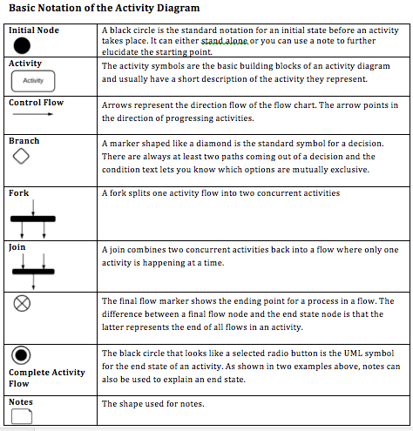
Activity Diagram Notations

Slide 23
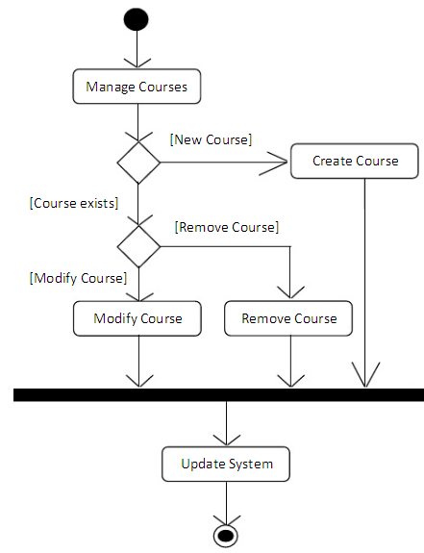
Create Activity Diagram for the following :-
Usecase – Manage course
Check course, if it’s a new course , create course and update in a system
Check course , if it’s a old course , then check whether modification is required or not ,else remove it and update the system.

Slide 24
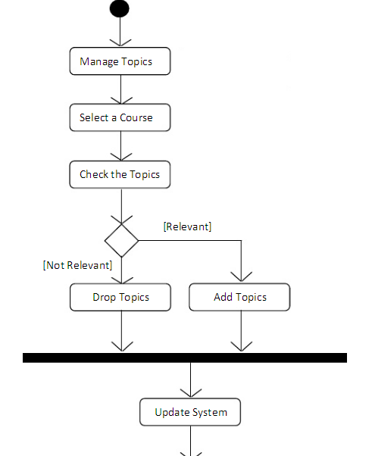
Manage Topics
Usecase – Manage Topics
Under Manage topics – select course then check topics .
If the topic is not relevant , drop topic and update system.
If the topic is relevant , add topic and update system.

Slide 25
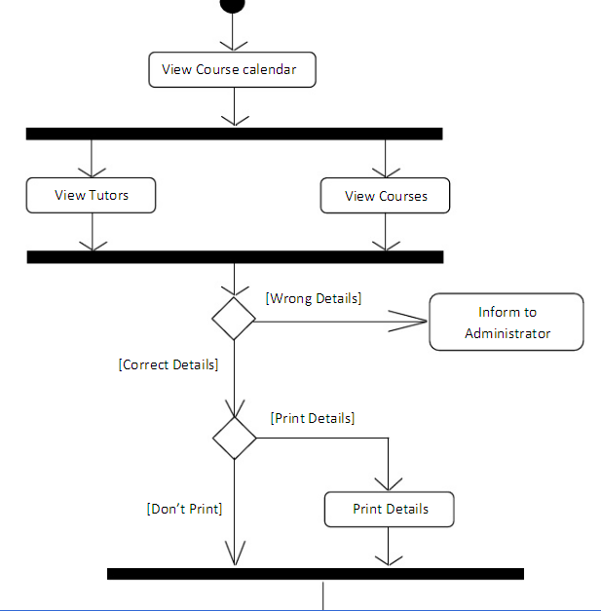
Create Activity Diagram :-
Use case – View Calendar
Under View calendar – view Tutor ,view course
Check if there is the Tutor and course matches, if details are found to be correct proceed for printing or else inform the administrator.
Also to Print details the option should be given and then the exit.

Slide 26
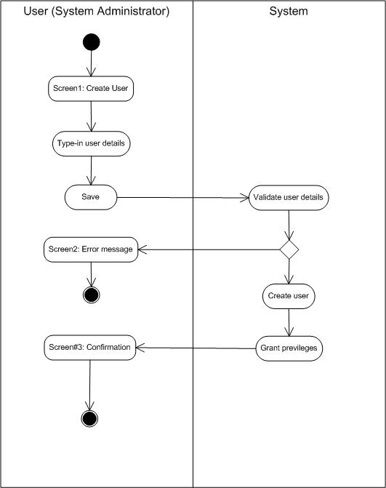
Swimlanes A swimlane is used in process flow diagrams, or flowcharts, that visually distinguishes job sharing and responsibilities for sub-processes of a business process. Swimlanes may be arranged either horizontally or vertically.

Slide 27
Activity Diagram Specification
Table 1
Table 2
Step | User | System Admin | Business Rules
1 | Create user
2 | Type user details |  | BR_1
3 |  | Validate User Details | BR_2
4 | Error Message |  | BR_3
5 |  | Grant Privileges | BR_4
6 | Confirmation |  | BR_5
7 | Exit |  | BR_6
ID | Business Rules | Business Rule description
BR_1 | User details | First Name Surname Address Email Home Contact No Office Contact No Contact No Zip Code
BR_2 | Validation for User details | Mandatory :- First Name Surname Contact No
BR_3 | Error Message | If BR_2 does not match.
BR_4 | Grant Privileges | Read only permissions Write permissions
BR_5 | Confirmation of successful user account | If BR_1, BR_2, BR_4 are successful
BR_6 | Exit | User exits successfully

Slide 28
Other Notations (Case Study –Shopping Cart )
User is registered and logs into system, searches for required item and then selects it, Clicks on Add to cart and the same time inventory is checked. Based on Pincode,type of delivery is asked "home " or "on counter store". Depending on time slot selected ,further payment module is been asked. Based on charges ,mode is asked for payment "Net banking" or "COD". Then order is generated. Order is seen by shipment people ,processed and dispatched, order status update

Slide 29
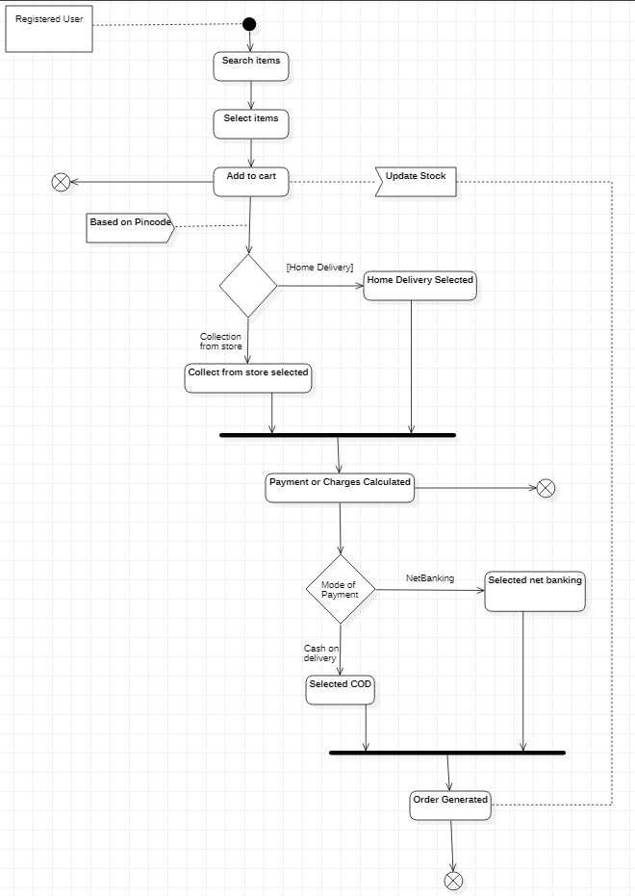

Slide 30
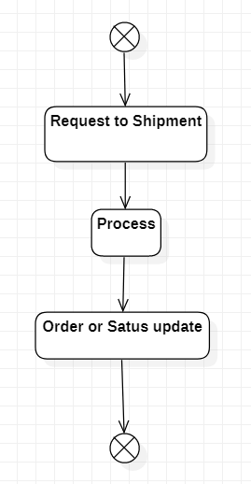

Slide 31
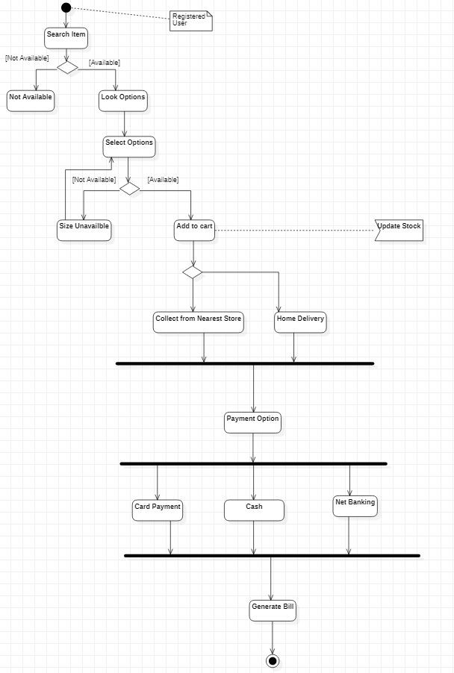

Slide 32
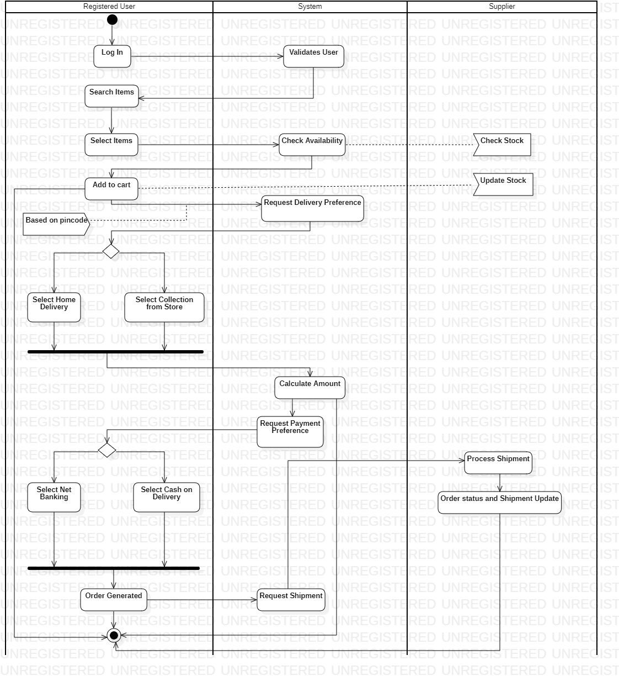

Slide 33
Refer this link
https://www.youtube.com/watch?v=w2hT8oo2iVo

Slide 34


Sequence Diagram Symbols
Symbols in Sequence Diagram
Use the UML object symbol to illustrate class roles, but don't list object attributes.
Activation or Execution Occurrence (Activation Block) Activation boxes represent the time an object needs to complete a task.
When an object is busy executing a process or waiting for a reply message, use a thin gray rectangle placed vertically on its lifeline.

Slide 35
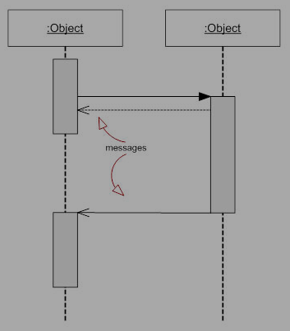
Sequence Diagram Symbols
Messages Messages are arrows that represent communication between objects. Use half-arrowed lines to represent asynchronous messages. Asynchronous messages are sent from an object that will not wait for a response from the receiver before continuing its tasks. For message types, see below.

Slide 36
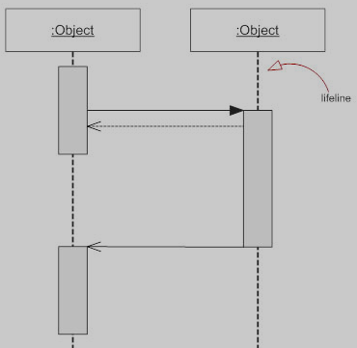
Sequence Diagram Symbols
Lifelines: Lifelines are vertical dashed lines that indicate the object's presence over time.
X
Destroying Objects: You can place an X at the end of its lifeline to denote a destruction occurrence.

Slide 37
Types of Messages in Sequence Diagrams
Synchronous Message A synchronous message requires a response before the interaction can continue. It's usually drawn using a line with a solid arrowhead pointing from one object to another.
Asynchronous Message Asynchronous messages don't need a reply for interaction to continue. The arrowhead is usually open and there's no return message depicted.

Slide 38

Sequence Diagram Symbols
Reply or Return Message A reply message is drawn with a dotted line and an open arrowhead pointing back to the original lifeline.
Self Message A message from an object sends to itself, usually shown as a U shaped arrow pointing back to itself.

Slide 39
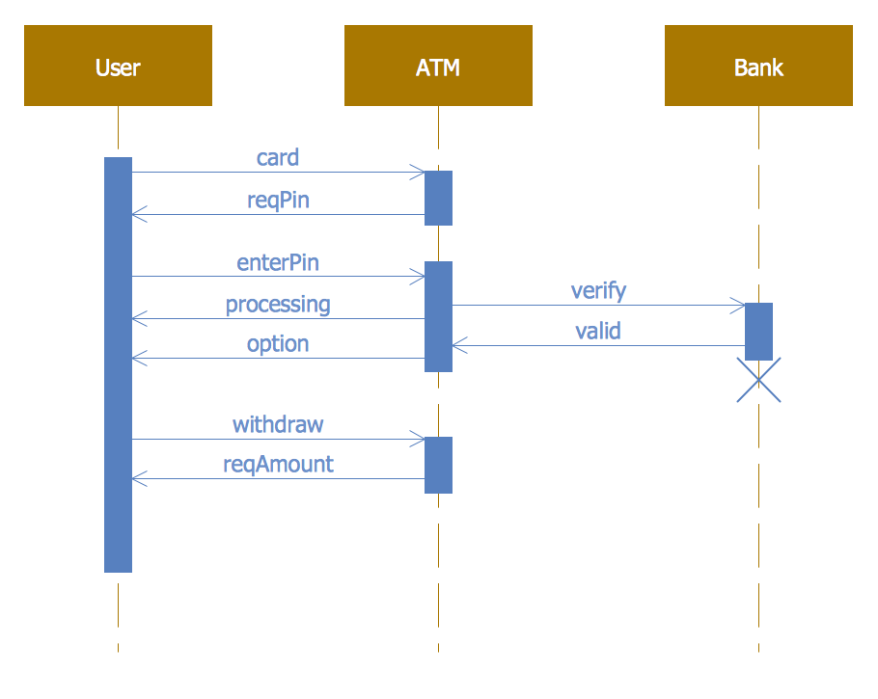
Sequence Diagram Example

Slide 40
Operator | Meaning
alt | Alternative multiple fragments; only the one whose condition is true will execute
opt | Optional; the fragment executes only if the supplied condition is true. Equivalent to an alt with only one trace.
par | Parallel; each fragment is run in parallel.
loop | Loop; the fragment may execute multiple times, and the guard indicates the basis of iteration.
sd | Sequence diagram; used to surround an entire sequence diagram, if you wish.

Slide 41
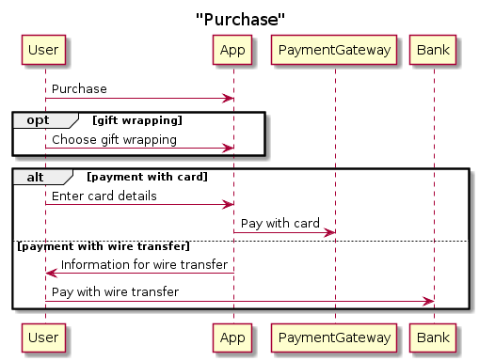
Example : Online Shopping

Slide 42
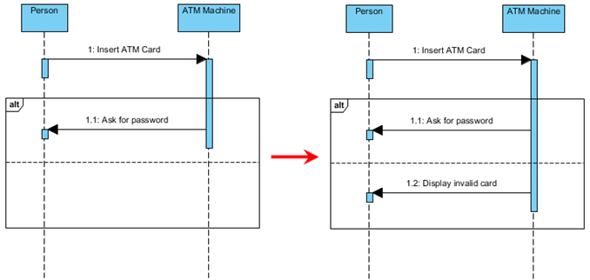
Alt - Fragment

Slide 43
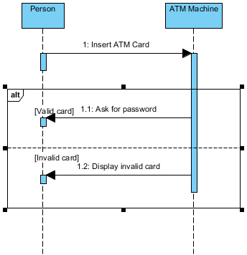
Alt – Fragment with guard

Slide 44
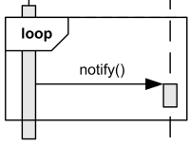
Sequence Diagram Symbols
Loops A repetition or loop within a sequence diagram is depicted as a rectangle. Place the condition for exiting the loop at the bottom left corner in square brackets .

Slide 45
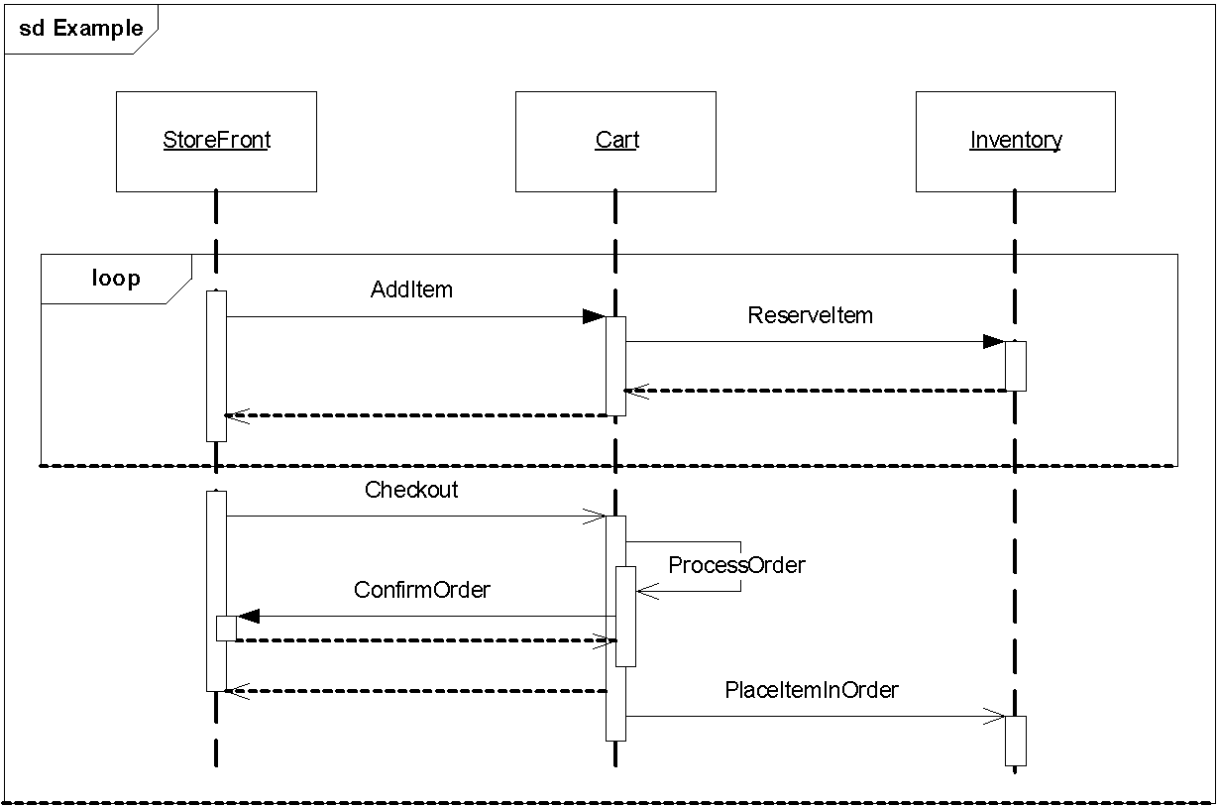
Example : Online Shopping

Slide 46
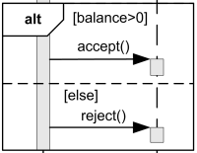
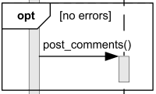
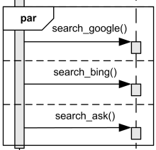
Types of Fragments

Slide 47
Can you answer these Questions for your working Project
Have you identified the scope of your system?
you should know whether you are diagramming a single application or the deployment to a whole network of computers.
How many machines will your application support ?
Will you require Cloud or data stored in local Machine ?
Will it be Centralized or Distributed in nature ?
Do you have all the nodes you need? Do you know how they are all connected?
How many files do you have in your project ?(lib, source,exe,.doc,web pages.……)
How many tables do you have in your project ?
In How many components you can divide your project ?

Slide 48
Component Diagram
Component diagram is a special kind of diagram in UML.
The purpose is also different from all other diagrams discussed so far.
It does not describe the functionality of the system but it describes the components used to make those functionalities.
Use component diagrams to model the static implementation view of a system.
This involves modeling the physical things that reside on a node, such as executables, libraries, tables, files, and documents.

Slide 49
Component Diagram
So the purpose of the component diagram can be summarized as:
Visualize the components of a system.
Construct executables by using forward and reverse engineering.
Describe the organization and relationships of the components.

Slide 50
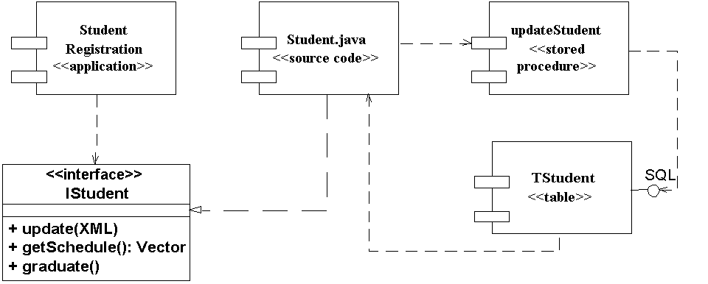
Component Diagram

Slide 51
Deployment Diagram
Deployment diagrams show the configuration of run-time processing elements and the software components, processes, and objects that live on them. Software component instances represent run-time manifestation of code units.
Deployment diagrams are useful for showing a system design after the following decisions are made
Subsystem decomposition
Concurrency
Hardware/Software Mapping
A deployment diagram is a graph of nodes connected by communication associations.
Nodes are shown as 3-D boxes.
Nodes may contain component instances.
Components may contain objects (indicating that the object is part of the component)

Slide 52
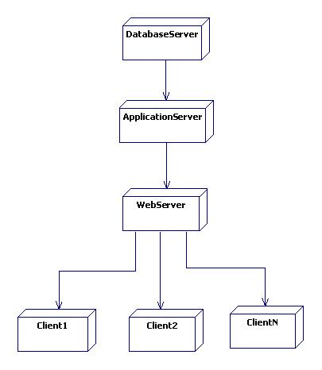
Deployment Diagram

Slide 53
Deployment Diagram
A Deployment Diagram shows the actual Hardware configuration consisting of
Nodes (processors)
Software - Components
Processes
Objects

Slide 54
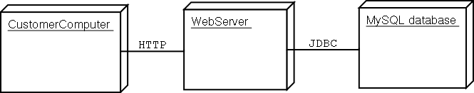
Deployment Diagram
Captures the distinct number of computers involved
Shows the communication modes employed
Component diagrams can be embedded into deployment diagrams effectively…

Slide 55
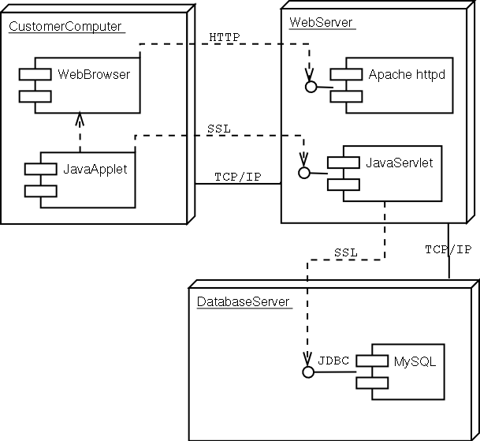
Deployment Diagrams

Slide 56
Answer the following questions ?
A Car has a starter switch, two headlights , an air conditioning system, and an accelerator pedal , The driver first operates the starter ,then the Air conditioning system, And finally presses the accelerator pedal,
Which of the diagrams is most useful to model the situation ?
Use case
Activity
Sequence
Component and Deployment

Slide 57
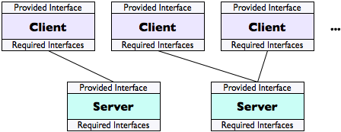
Architectural Design –Client Server
In a client-server architecture, one component, the server, provides an interface that other components, the clients, connect to as needed to request the service provided by the server.
The set of clients is often variable, and the connections are commonly made only as needed. There may be several servers providing the same services, in which case a client may connect to any, and may look up a server in some kind of directory in order to locate an appropriate one; clients may be directed to whichever server is least busy, in order to balance the load and provide fastest service.

Slide 58
Name | Client-server
Description | In a client–server architecture, the functionality of the system is organized into services, with each service delivered from a separate server. Clients are users of these services and access servers to make use of them.
Example | The film and video/DVD library organized as a client–server system.
When used | Used when data in a shared database has to be accessed from a range of locations. Because servers can be replicated, may also be used when the load on a system is variable.
Advantages | The principal advantage of this model is that servers can be distributed across a network. General functionality (e.g., a printing service) can be available to all clients and does not need to be implemented by all services.
Disadvantages | Each service is a single point of failure so susceptible to denial of service attacks or server failure. Performance may be unpredictable because it depends on the network as well as the system. May be management problems if servers are owned by different organizations.

Slide 59

Architecture Design –Pipe and Filter
A pipe-and-filter architecture utilizes components that are filters: they take a sequence of inputs and produce a sequence of processed outputs from it. The outputs of each filter become the inputs of the next filter in the pipeline. The system may rearrange the filters in the pipeline at run time, substituting, adding, or deleting filters to achieve different results.

Slide 60
Name | Pipe and filter
Description | The processing of the data in a system is organized so that each processing component (filter) is discrete and carries out one type of data transformation. The data flows (as in a pipe) from one component to another for processing.
Example | The pipe and filter system used for processing invoices.
When used | Commonly used in data processing applications (both batch- and transaction-based) where inputs are processed in separate stages to generate related outputs.
Advantages | Easy to understand and supports transformation reuse. Workflow style matches the structure of many business processes. Evolution by adding transformations is straightforward. Can be implemented as either a sequential or concurrent system.
Disadvantages | The format for data transfer has to be agreed upon between communicating transformations. Each transformation must parse its input and unparse its output to the agreed form. This increases system overhead and may mean that it is impossible to reuse functional transformations that use incompatible data structures.

